Slide 1
ACTION RESEARCH
How can widening participation students from the CSM Insights programme be more supported by the BA Fashion staff team and receive a more inclusive educational experience by being better prepared so that we can work towards achieving greater social justice through a higher attainment and retention rate from this student demographic
Stephanie Cooper, Pathway Leader, BA Fashion Design : Communication Central Saint Martins

Slide 2
Through my study, I researched if there is a need for targeted support for CSM Insights students and questioned how to instill more of a sense of belonging for students from this specified background.
I created a study of student and tutor experiences based on collecting data from questionnaires and interviews.
By analysing responses from both student and tutor perspectives, I formed a clear understanding of how I can propose to create additional support to students.

Slide 3
CSM INSIGHTS
My focus is specifically on students from the CSM Insights outreach programme. Students are selected if they identify as being the 1st person in their family to go to university or from a priority postcode area, a low income family or have experience of being in care.
Insights students can frequently encounter specific barriers to high levels of attainment such as through economic restrictions, care responsibilities and a lived experience of a lack of accessible art and design education.
As we are increasing the numbers of widening participation applicants when recruiting students, in line with the University inclusivity and diversity policies, we need to act positively to improve the attainment levels and the retention of students from this demographic.

Slide 4
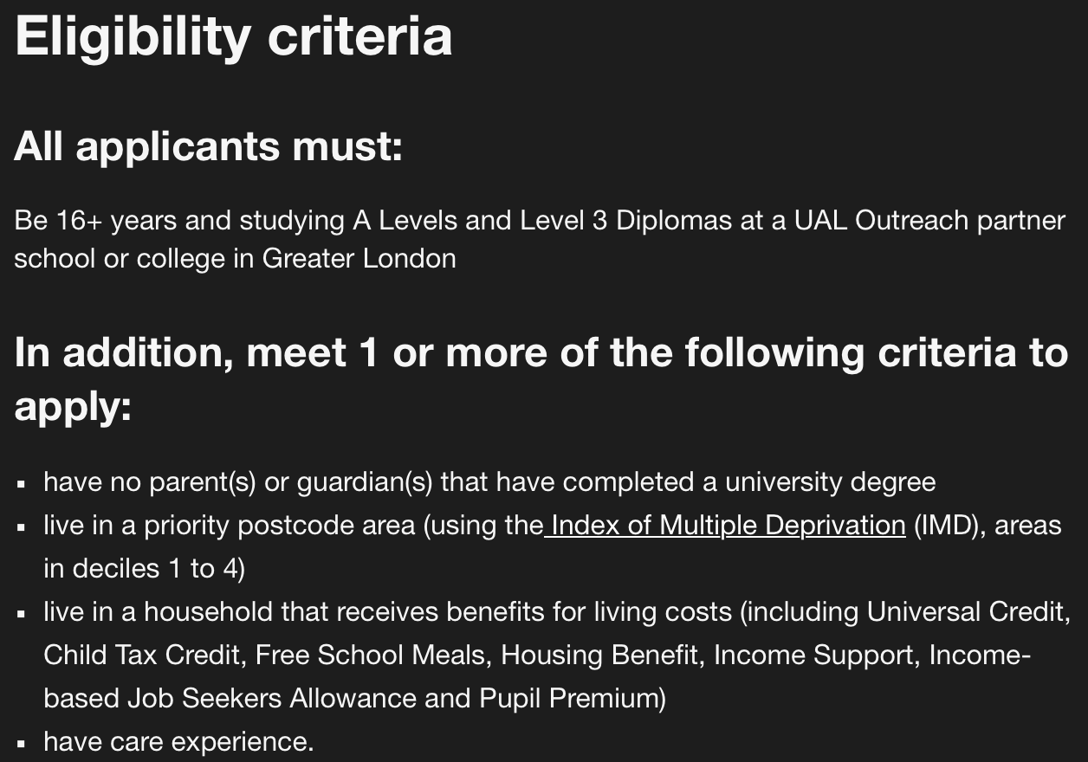

Slide 6
POSITIONALITY
From my own life experience coming from a low income, widening participation background, where I was the first in my family to go to university, I can fully reflect on how my personal circumstances relate to the social justice aspects of this study.
From my experience as Pathway Leader, BA Fashion Design:Communication, I have reflected on the difficulties students from widening participation backgrounds experience when entering the BA Fashion courses and this can lead to students under achieving, taking planned time out or in some cases even withdrawing permanently from their courses.

Slide 7
RESEARCH METHODS

Slide 8
APPROACH
Staff Interviews and Questionnaires
I created a focussed study from the BA fashion programme and from the CSM Insights programme to gather relevant data from their perspectives.
Student Questionnaires
Involving BA fashion students who are from the CSM Insights programme requesting information regarding their experience transitioning on to the BA Fashion courses at CSM.
Quantative
Analysing responses, from a diverse selection of interviewees and collecting response data, through questionnaires and interviews.
Qualitative
Assessing the responses collected from questionnaires and interviews through close analysis, by comparing and contrasting responses that inform the factors that create barriers

Slide 9
STAFF PARTICIPANTS
TUTOR 1
Pathway Leader BA Fashion
TUTOR 2
BA Cross Pathway Tutor
TUTOR 3
Pathway Leader BA Fashion
TUTOR 4
Pathway Leader BA Fashion
TUTOR 5
1st Year tutor BA Fashion
TUTOR 6
Insights Outreach team member

Slide 10
INTERVIEW QUESTIONS (BA Fashion Staff)
QUESTION 1
In your experience, do you find that students from the Insights programme route and Widening Participation backgrounds experience specific barriers when beginning the BA course?
QUESTION 2
What key barriers do you believe students from widening participation, Insights programmes face when beginning the BA course?
QUESTION 3
Do you find that students from widening participation, Insights programmes are less likely to seek support and admit that they are finding the course difficult ?
QUESTION 4
In what form do you think additional support could be given?
QUESTION 5
In your experience, have students from widening participation, Insights programme withdrawn from the course, requested time out or had to repeat units due to non-submission or not gaining a pass grade in projects ?

Slide 11
KEY EXAMPLES TUTORS : BA FASHION Students from Contextual Admissions consistently experience difficulties at all stages of their courses, but it is most evident in their first year, and more specifically their first term. Introducing a programme or a series of workshops prior to students applying or beginning the BA course, would help immensely to raise understanding, knowledge, skill and importantly confidence in what research means, how to develop a project, life drawing classes, a basic cut and make class where they could learn how to make a garment. Students would benefit from more contact time with BA tutors who can support them before they commence BA studies with concept building, research and drawing.

Slide 12
KEY EXAMPLES : INSIGHTS STAFF
Specialist tuition is definitely needed with current tutors on the BA course to be able to communicate what creative processes they are expecting.
The aim is that we support Insights students in advance with more tuition from BA tutors so that they can prepare ahead and be aware of what the expectations might be.

Slide 13
Thematic Analysis After reviewing the information from answers in the questionnaires and interviews, I analysed the participant responses. By identifying key statements, examples and recurring descriptions of experiences, my aim was to form a greater understanding of connected viewpoints.

Slide 14
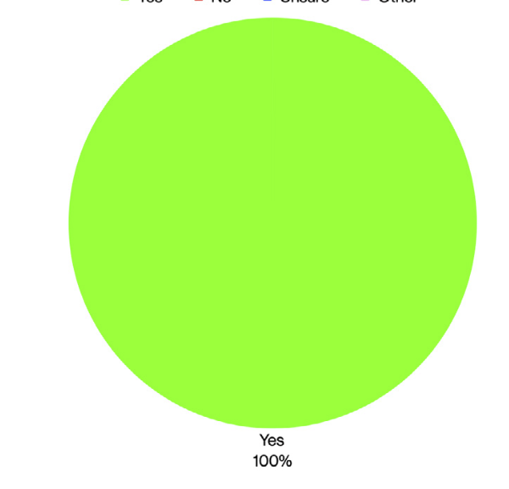
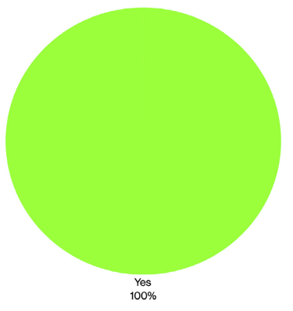
THEMATIC ANALYSIS : STAFF
In your experience, do
you find that students from the Insights route experience certain barriers when beginning the BA course?
Do you find that students from Insights are less likely to seek support and admit that they are finding the course difficult ?
Do you think additional support could be added to the course structure to enhance the learning experience on the Insights course such as access to equipment, studio space and additional specialist tuition?
In your experience, have students from Insights withdrawn from the course, requested time out or had
to repeat units due to non submission or not passing projects ?

Slide 15
ANALYSIS : STAFF All staff participants agreed that students from the Insights programme are experiencing significant barriers to positively progressing in their learning. 1.Financial difficulties and not having access to equipment. 2.Lack of feeling a sense of belonging. 3.Lack of cultural capital. 4 Limited experience in conducting research and researching in a library. 5. Insufficient skills in concept building, drawing and technical skills to allow freedom in creative experimentation. There is a perceived connection between the specified barriers and attainment and retention levels.

Slide 16
STUDENT PARTICIPANTS STUDENT 1 BA Fashion Design 2nd year STUDENT 2 BA Fashion Design Graduate STUDENT 3 BA Fashion Design Graduate STUDENT 4 BA Fashion Design 2nd year

Slide 17
INTERVIEW QUESTIONS (Students)
QUESTION 1
Can you tell me how you found the transition to BA from your previous course.
Did you experience significant barriers ?
QUESTION 2
What barriers did you face in your first year of study.
QUESTION 3
Did you feel that you needed more support outside of the existing available resources.
QUESTION 4
In what form would you consider this additional support would ideally take to help you progress and flourish in your studies.

Slide 18
KEY EXAMPLES : STUDENTS
Some practical workshops in research would have supported me before beginning the BA course and would have helped me to be able to be more self reliant and motivated in this area.
More support tutorials or the running of a course prior to starting the BA, so you get a better idea of what to expect and have experience in presenting and talking about work in front of a group of people.
I struggled with not yet feeling confident in some of the technical aspects, such as research, development, and pattern cutting. Not being entirely sure of these fundamentals sometimes made it hard to feel fully engaged in my creative process.
Having access to experts from the BA who could demonstrate and troubleshoot complex techniques would have been incredibly helpful.

Slide 19
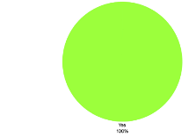
THEMATIC ANALYSIS : STUDENTS
Did you experience significant barriers to your learning when you commenced your BA course?
Did you feel that you needed more support outside of the existing available resources while studying on the insights course?
Would the existence of additional workshop sessions with BA tutors pre BA to build skills in research and technical development have supported you further before beginning BA?

Slide 20
ANALYSIS : STUDENTS
The student participants all agreed that they experienced significant barriers to positively progressing in their learning. 1.A lack of ability in conducting research.
2. A lack of cultural capital.
3.Insufficient skills in concept building, drawing and technical skills to allow freedom in creative experimentation.

Slide 21
PROJECT FINDINGS

Slide 22
Undertaking this Action Research project has highlighted specific barriers students from the CSM Insights programme face when embarking on the BA Fashion courses. I found there was a definite need to propose a system of support to help Insights students to prepare for BA studies.

Slide 23
IDENTIFYING SPECIFIC SUPPORT NEEDS
1. Creative research skills, support in using the library.
2. Concept building and experimentation in creative design processes and drawing.
3. Initial technical skills including using a sewing machine and basic pattern cutting and draping techniques.

Slide 24
PLAN OF ACTION
1.To present my Action Research project findings in depth to BA Fashion staff.
2.To work collaboratively with the Insights practitioner team and BA tutor team to implement additional support.
I WILL PROPOSE THE FOLLOWING PLAN FOLLOWING MY STUDY
A library research session to support students in how to use the library services with the dedicated fashion librarian at CSM.
Sessions with BA Fashion staff on concept building and how to process visual research.
Fashion drawing classes with an illustration tutor.
Workshops with a technical tutor in basic skills in cutting, drape and inductions in how to thread and use a sewing machine.

Slide 25
REFERENCES A Pedagogy of Social Justice for Education:Society,Identity,Theory, Intersectionality and Empowerment Hahn Tapper, AJ https://www.bera.ac.uk/publication/ethical-guidelines-for-educational-research-fifth-edition-2024-online [PDF] academia.edu Students’ Experience of Identity and Attainment at UAL D Subri – London:: Centre for Public Policy Research, King’s …, 2017 – academia.edu Thematic Analysis (Braun & Clarke, 2006). The Theory and practice of culturally relevant education, Aronson B. Laughter. https://www.weareface.uk/ Download

